Slide 1
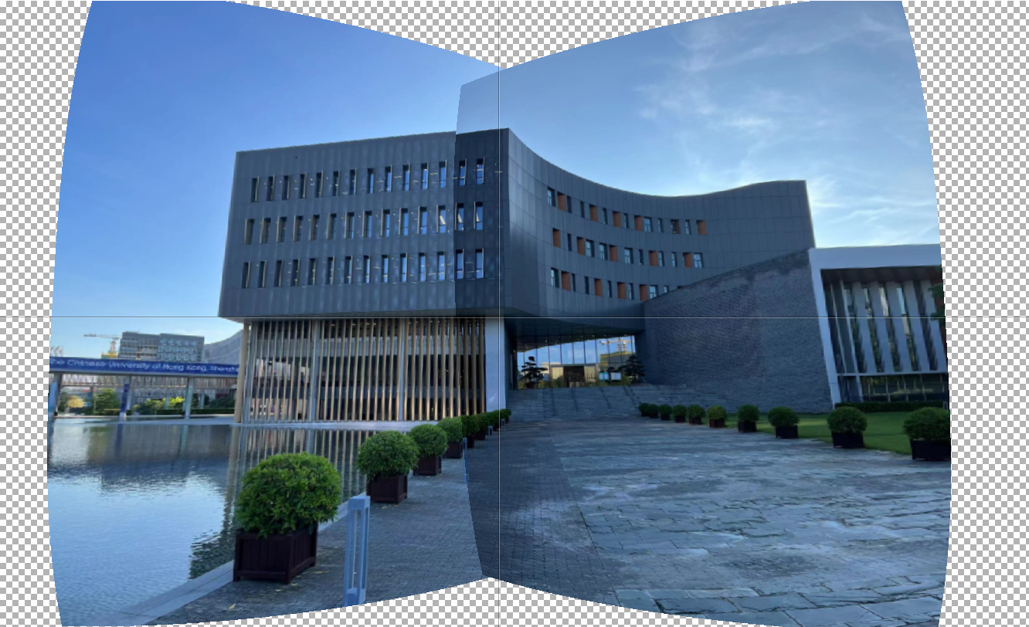
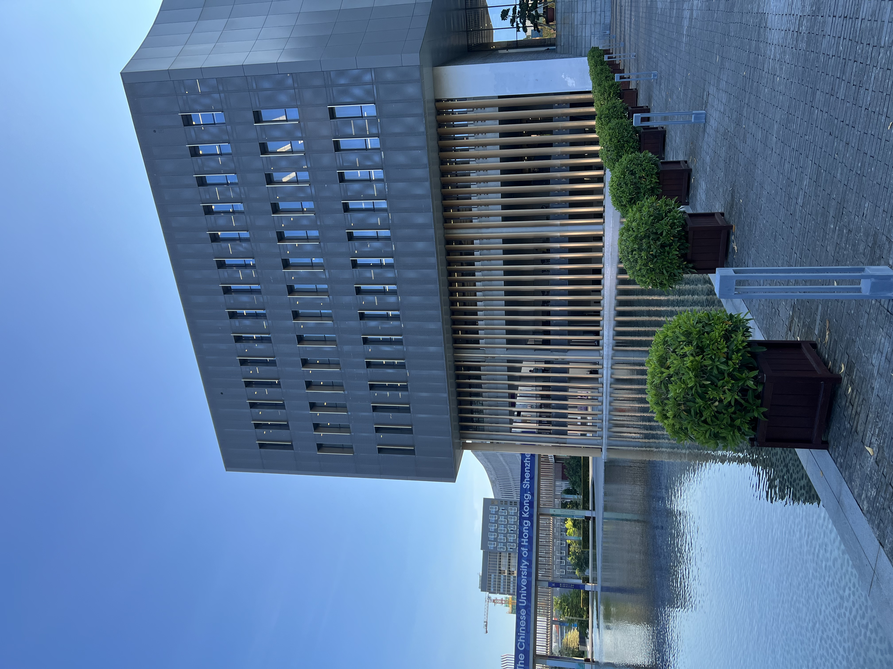
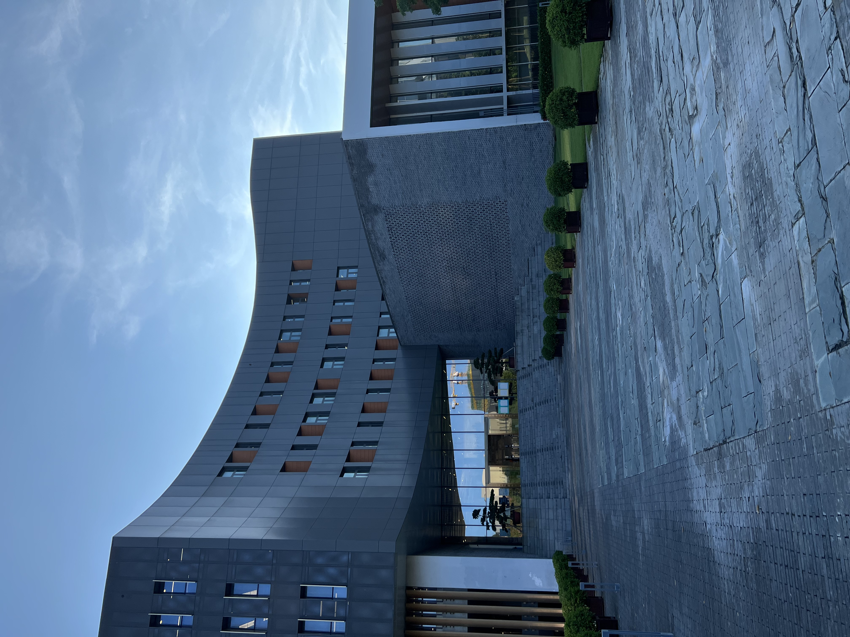
Obtaining High-quality Panorama from Video Eric Zhao Shuheng Zhang
Motivation: The technology of stitching a set of images is widely used today. Sometimes we want to obtain a panorama from a video that is captured from a stationary point by rotating the camera. However, the video may suffer from motion blur, which is not wanted when we try to construct a panorama from it. In our project, we try to construct a panorama from a video, and tentatively solve the motion blur problem of the panorama.

Slide 2
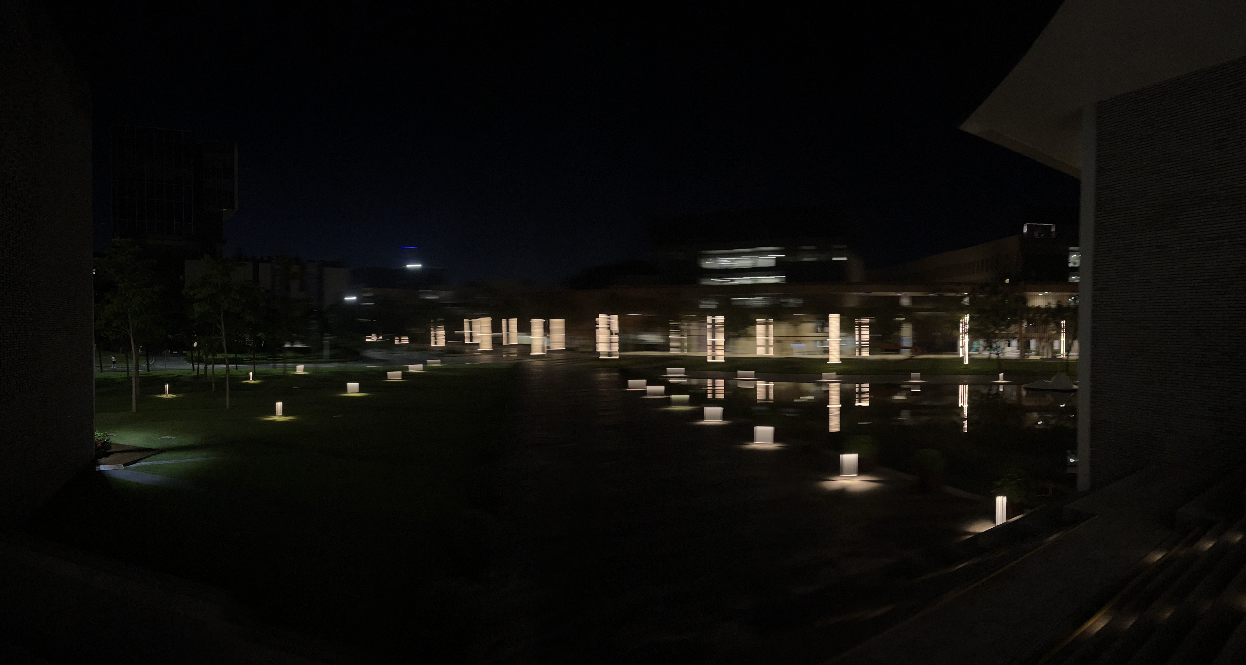
Goal and Methodology
Goal 1: Construct the panorama from a video
Goal 2: Deblur the video to get a high-quality panorama
Plan of Action
Achieves image stitching.
Achieves video stitching.
Predicts the blurring model by the movement of the camera and create a high-quality panorama by deblurring.

Slide 3

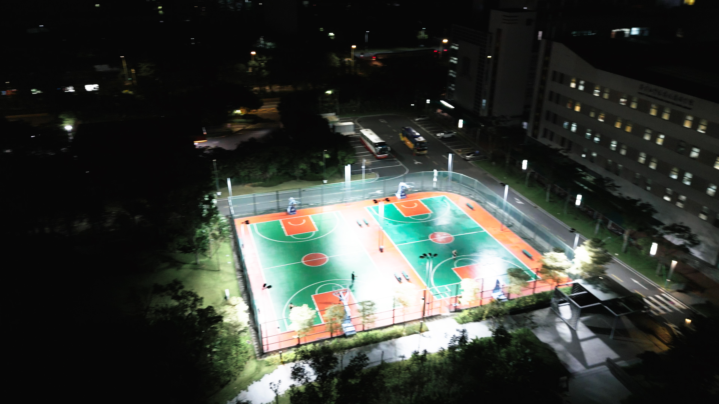
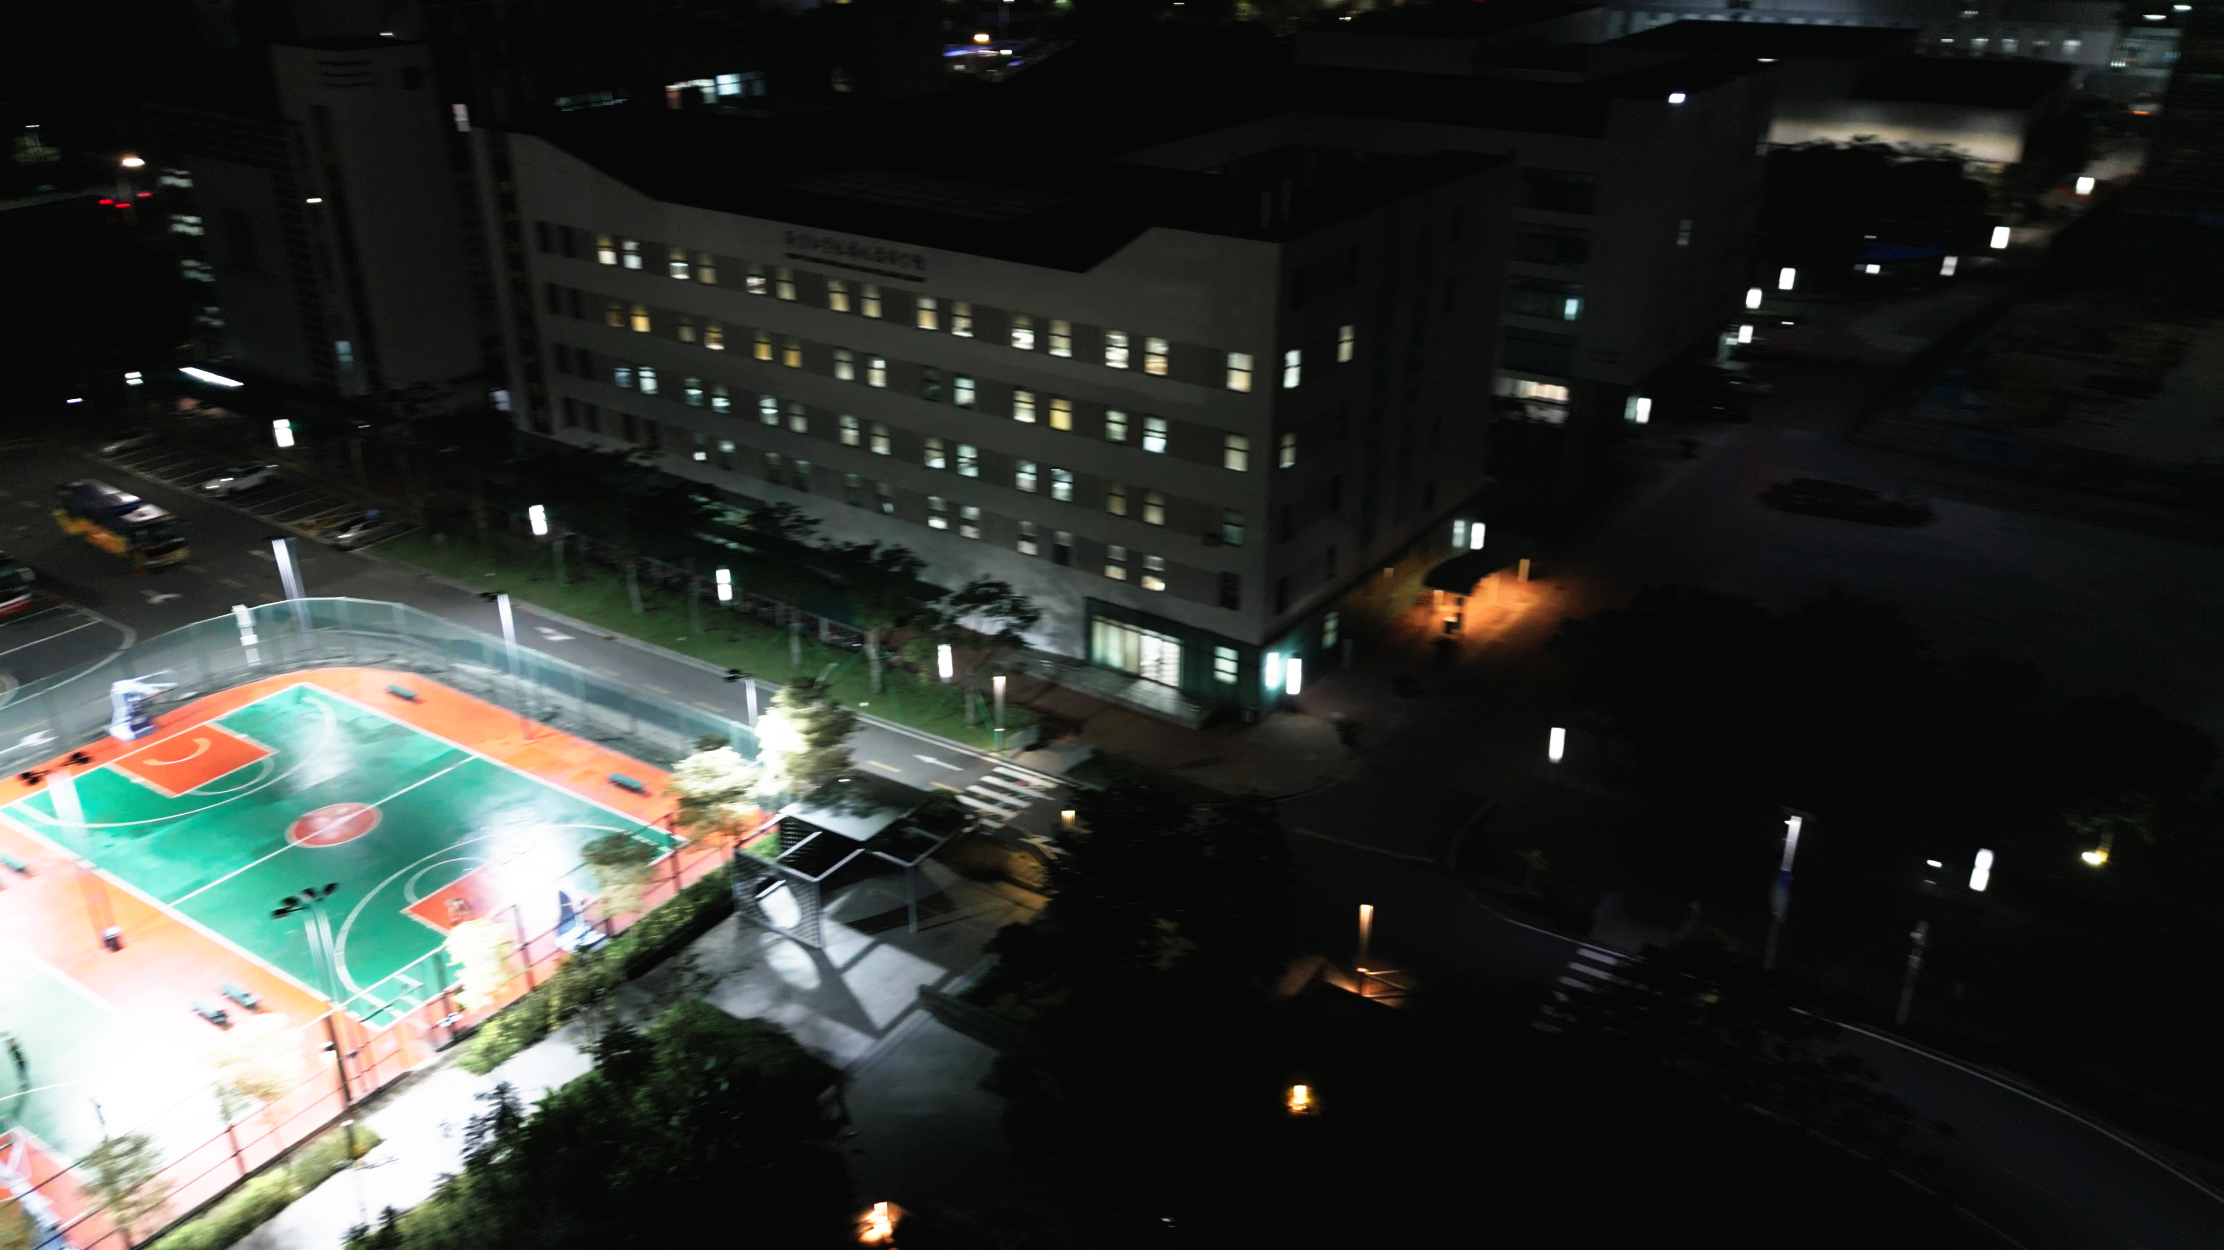
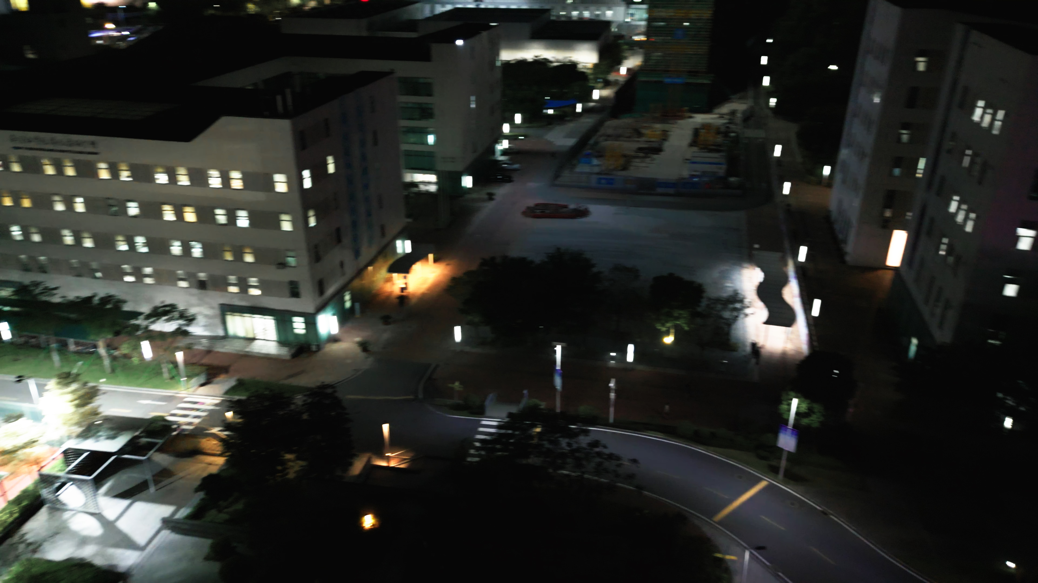
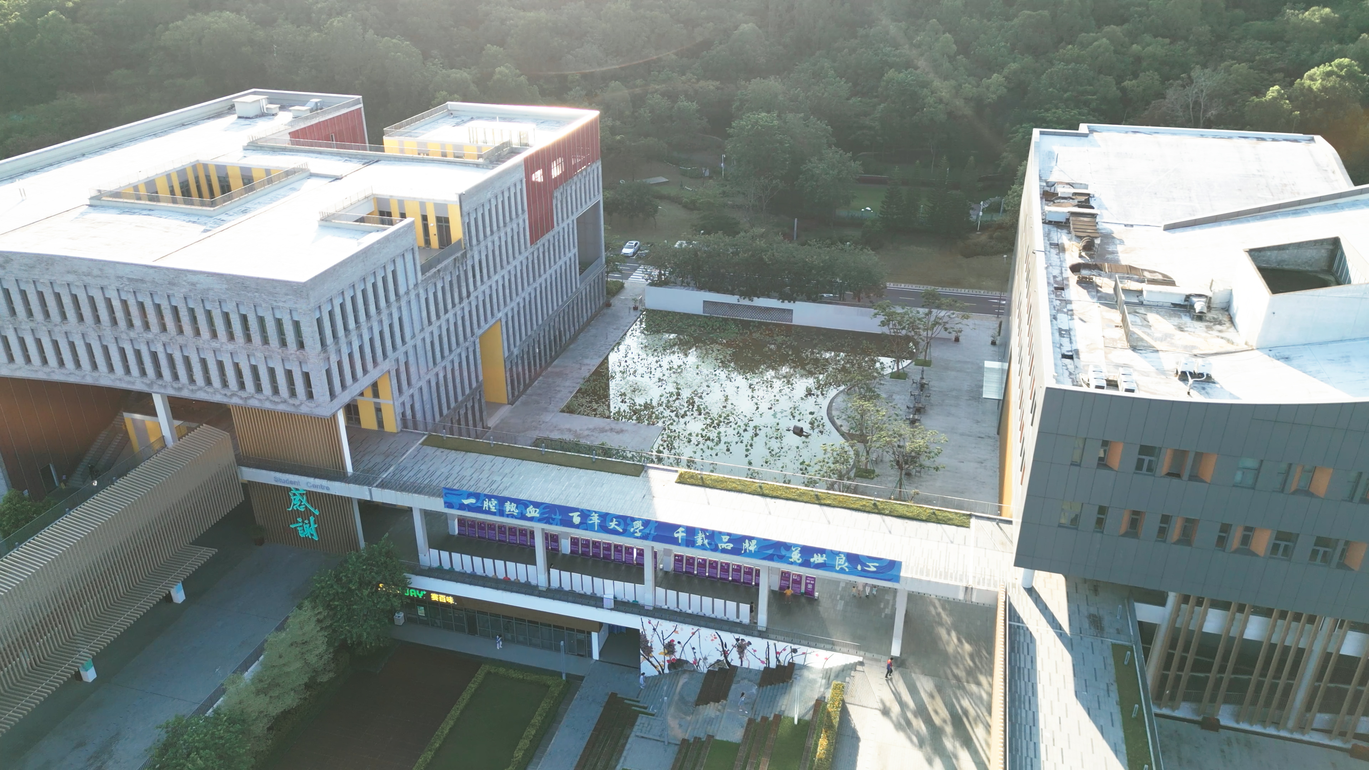
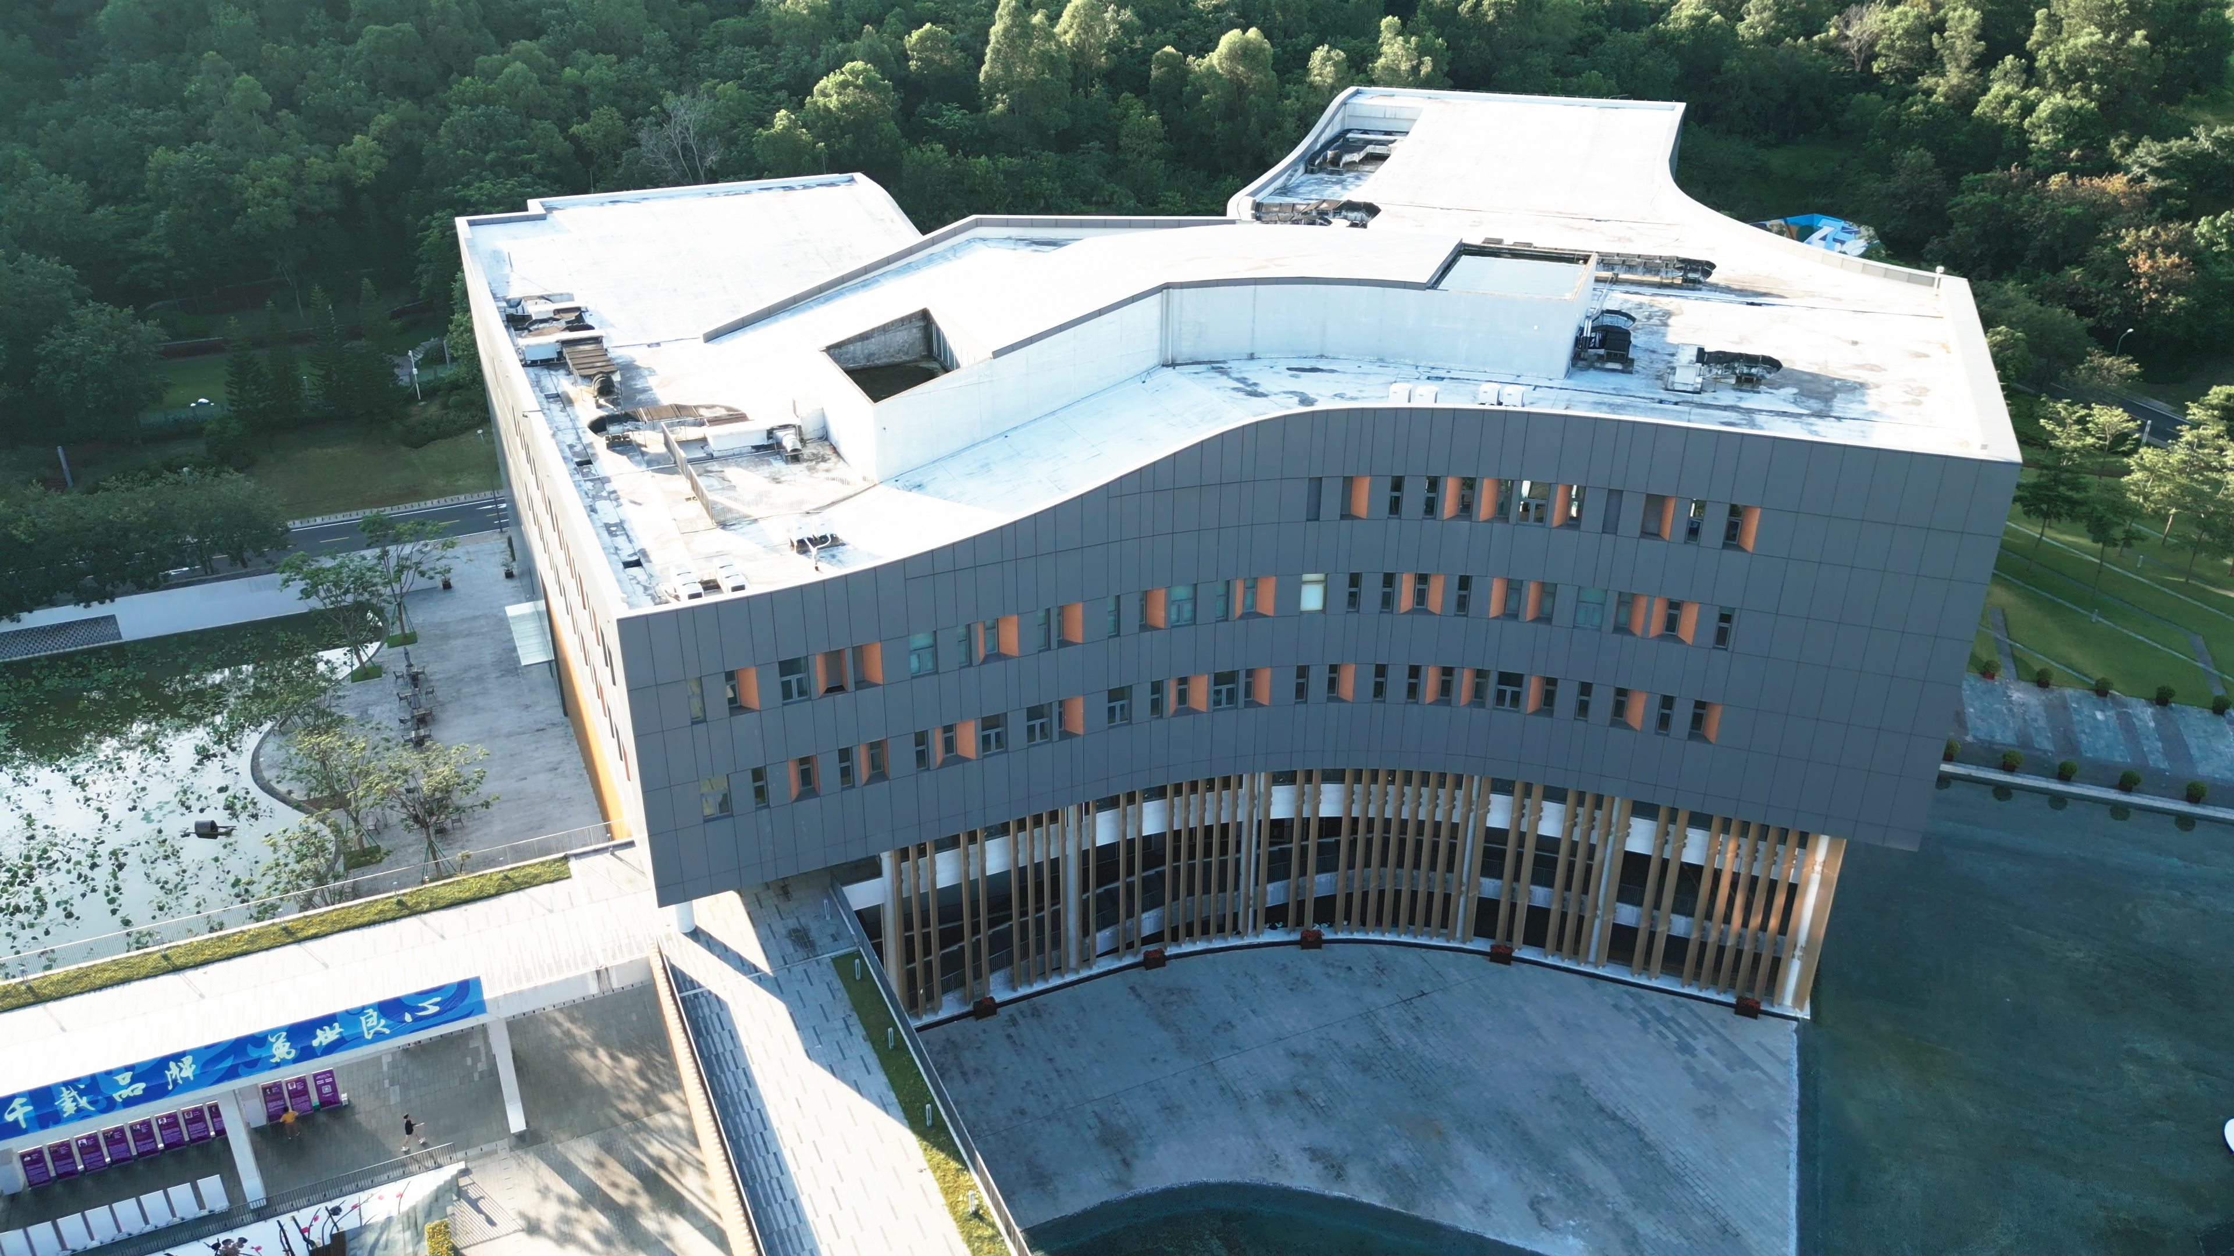
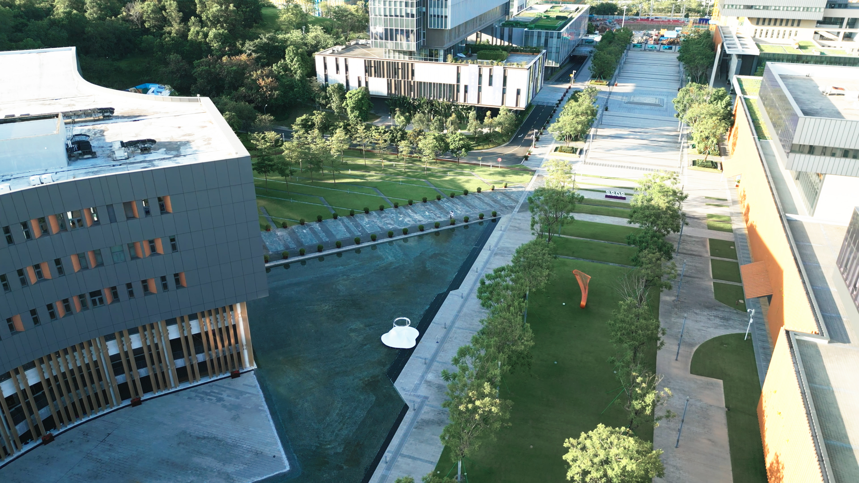
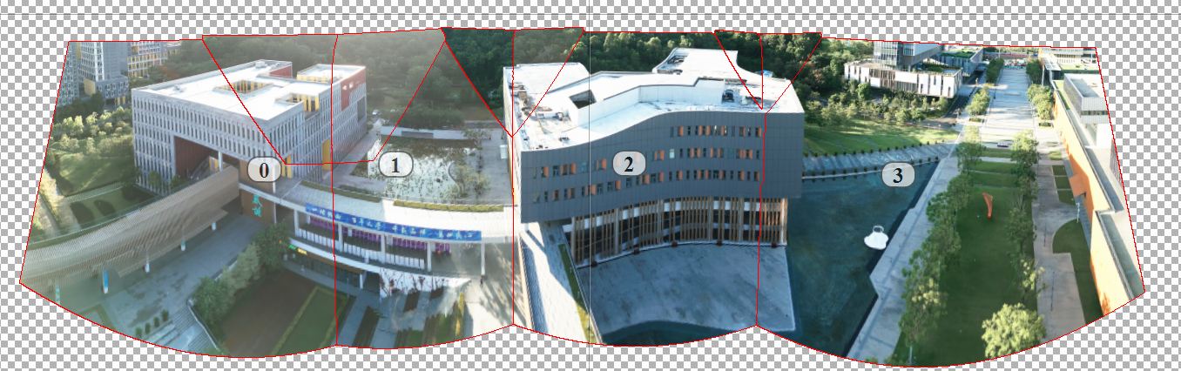
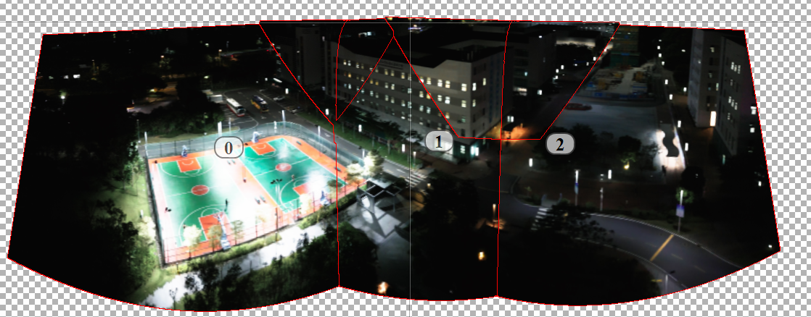
Dataset and Initial Results
Video file captured by camera
(Poor illumination)
Selected frames
(Unsatisfactory result suffering from motion blur)
Resulted panorama (an illustration by software PTGui)

